Slide 1
‘SubTracked’
Full Stack Application
Connor Flynn, Finlay George & Daniel Waldow

Slide 2
What is SubTracked?
Purpose
The SubTracked application is a subscription management platform, allowing users to roll all of their subscriptions together into one easy web application. This allows users to manage their subscriptions with ease, removing the stress of not knowing when payments are due.

Slide 3
What is SubTracked?
Functionality and Features
SubTracked features:
an intuitive design inspired by a 'less is more' approach, making it is easy to navigate and manage subscriptions
alerts to notify users when they have upcoming payments, including cost and due date
a flexible creation system allowing for any subscription to be managed by users, including the facility to edit and delete subscriptions as needed

Slide 4
What is SubTracked?
Target Audience
SubTracked is designed for anyone who wants to keep up to date with their subscriptions and take control of their subscription costs
Tech Stack
SubTracked features a diverse tech stack, including:
Ruby on Rails, JavaScript, React, HTML5, CSS3, PostgreSQL Database
Deployed on: Heroku (Backend) & Netlify (Frontend)

Slide 5
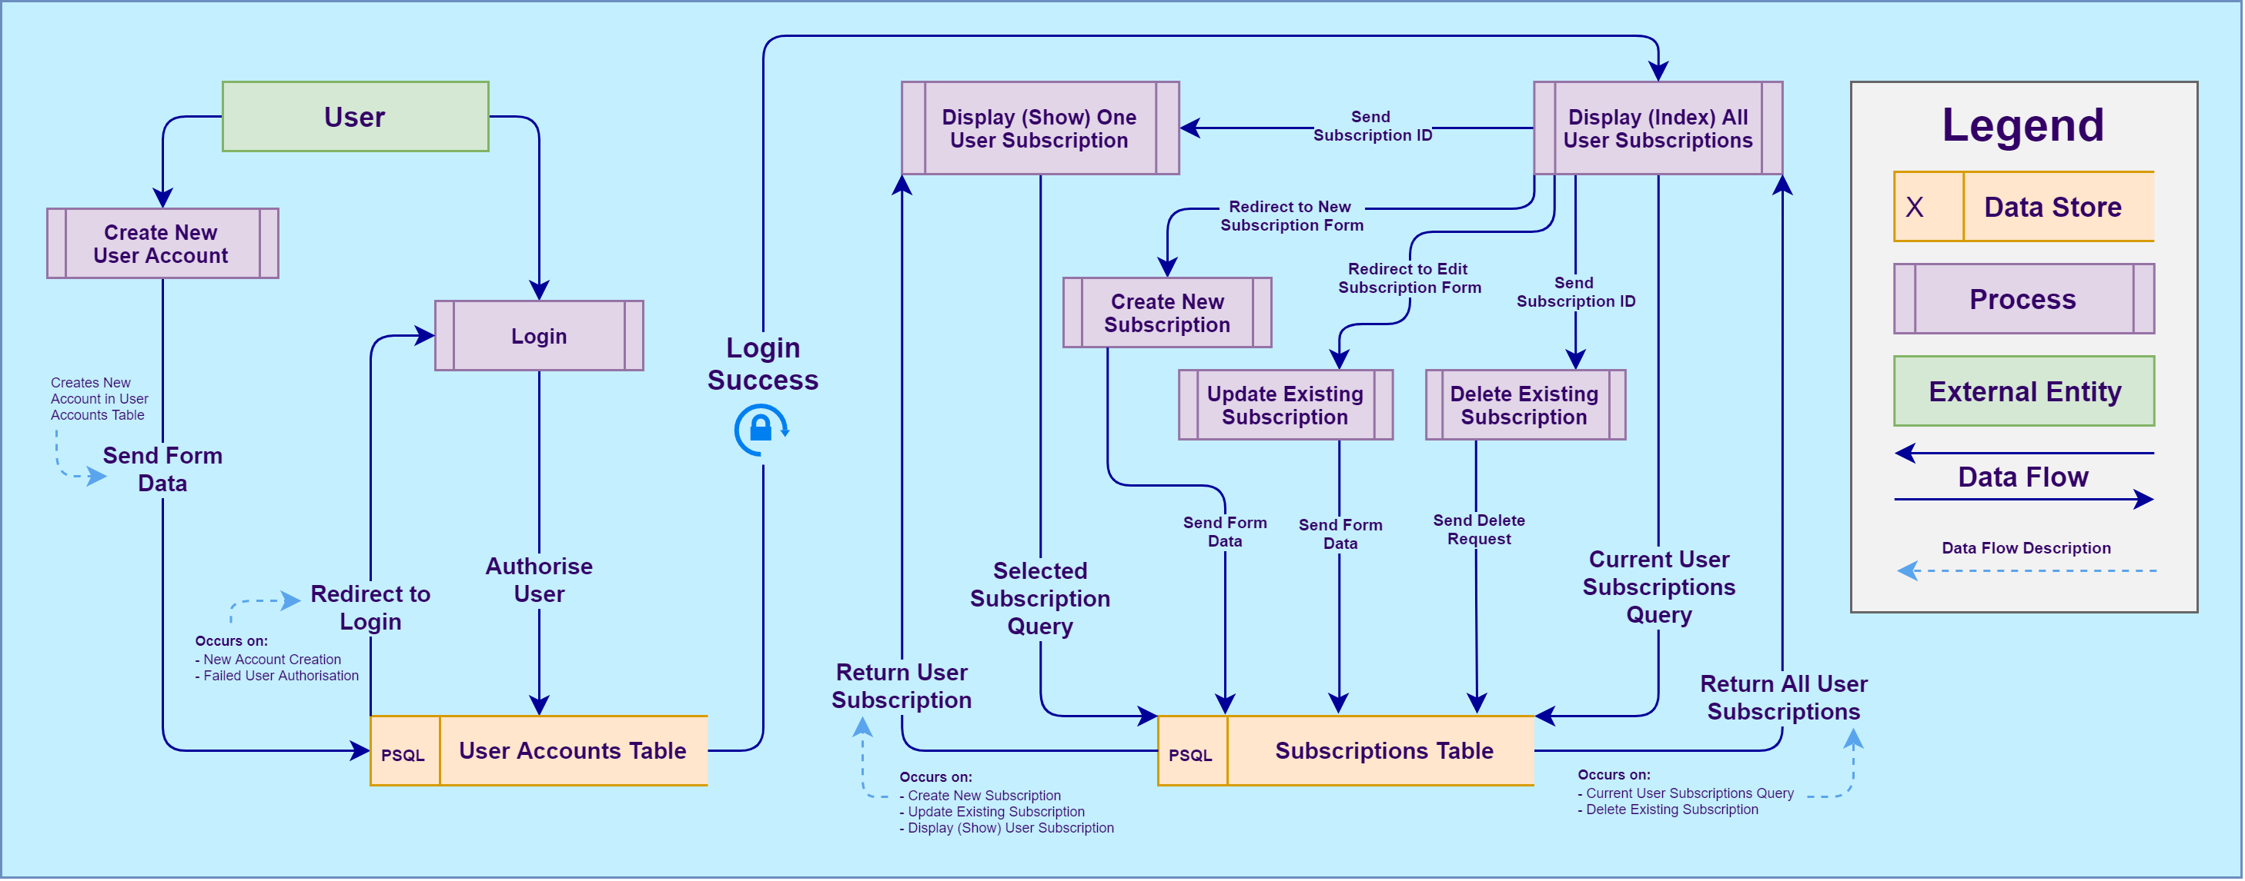
Data Flow

Slide 6
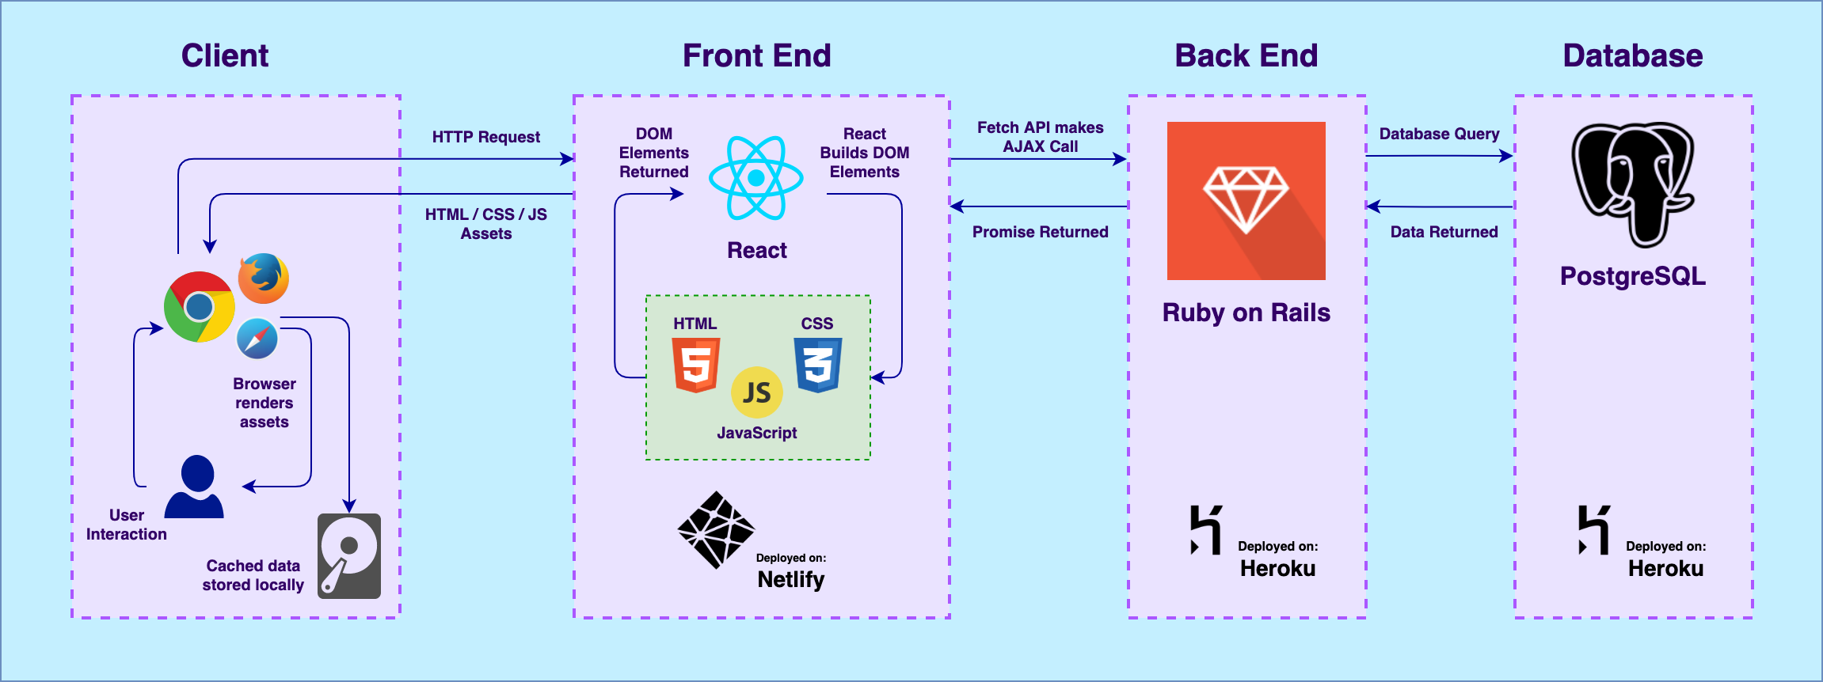
Application Architecture

Slide 7
User Stories?
As a user, I want to:
be able to keep track of my paid subscriptions in order to budget and keep on top of my finances
be able to create and edit my own subscriptions, including the billing frequency and amount
be able to delete subscriptions after I've unsubscribed from them
be alerted when a subscription is due and how much it will cost
be able to navigate the application easily via a simple and intuitive interface

Slide 8
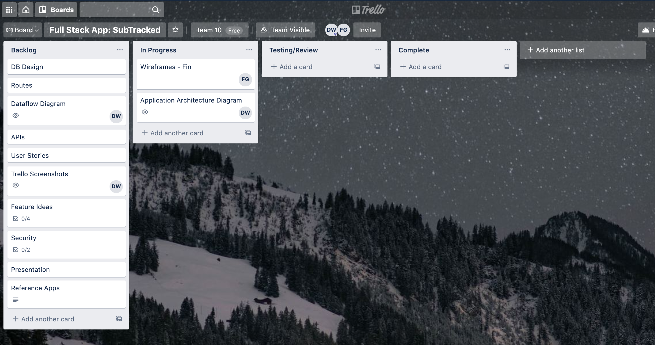
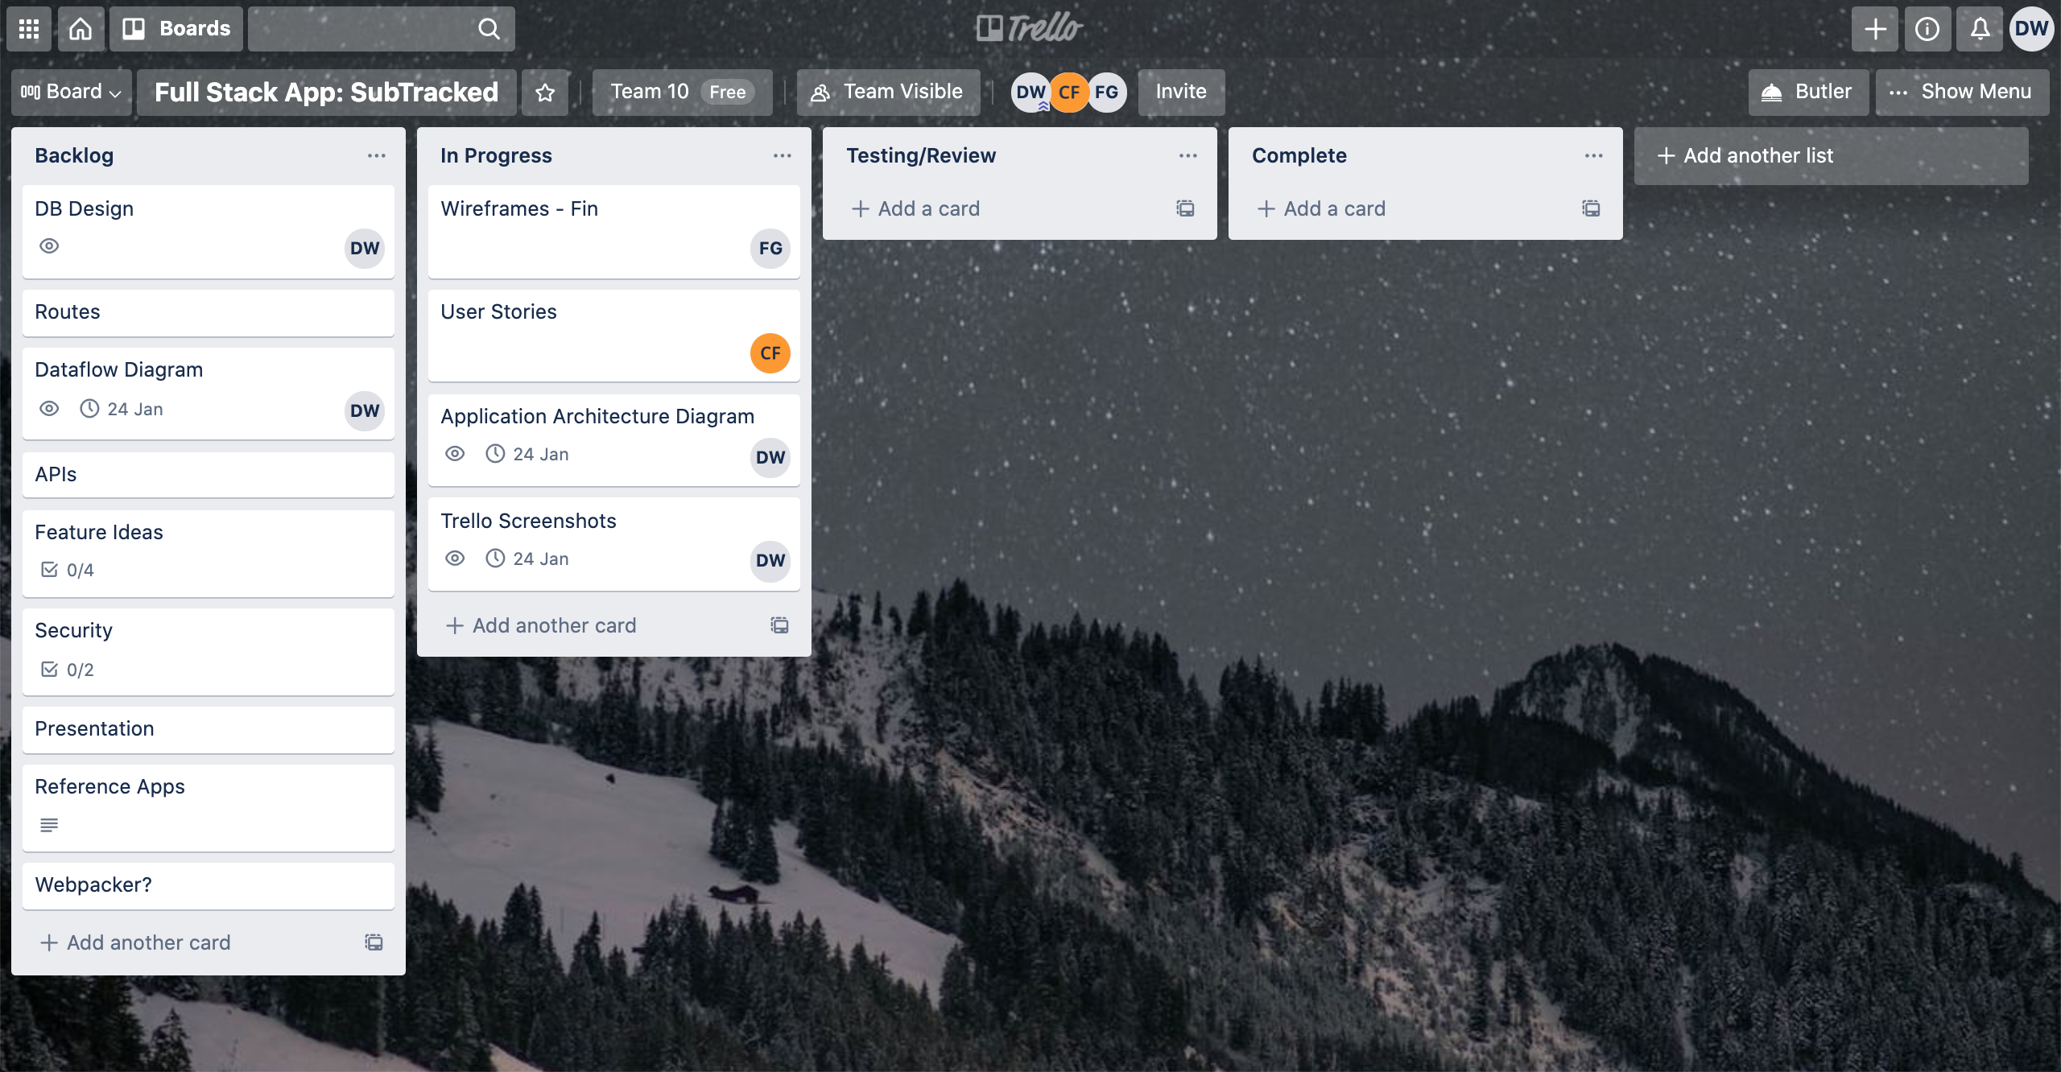
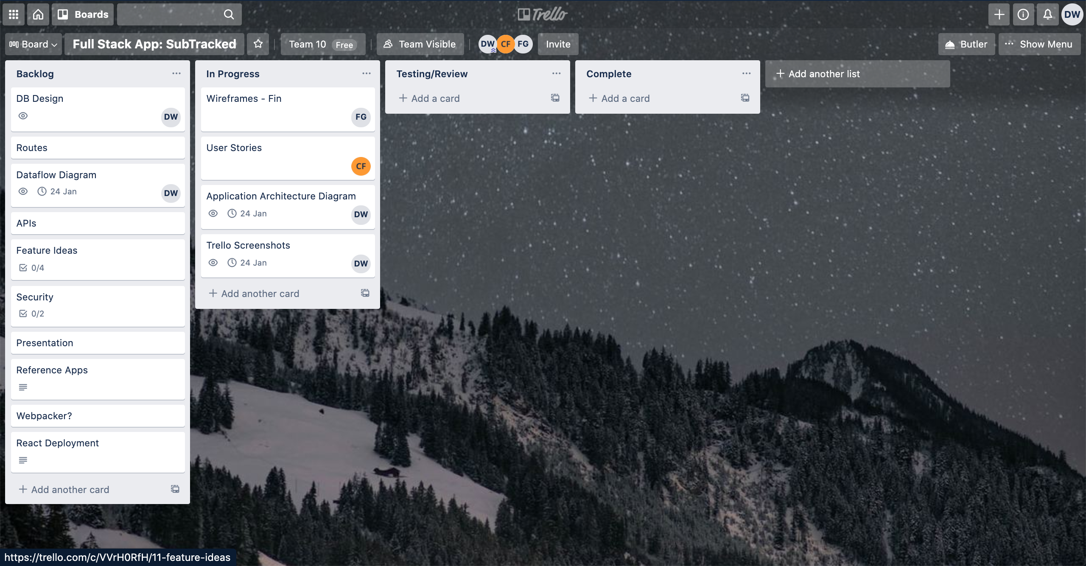
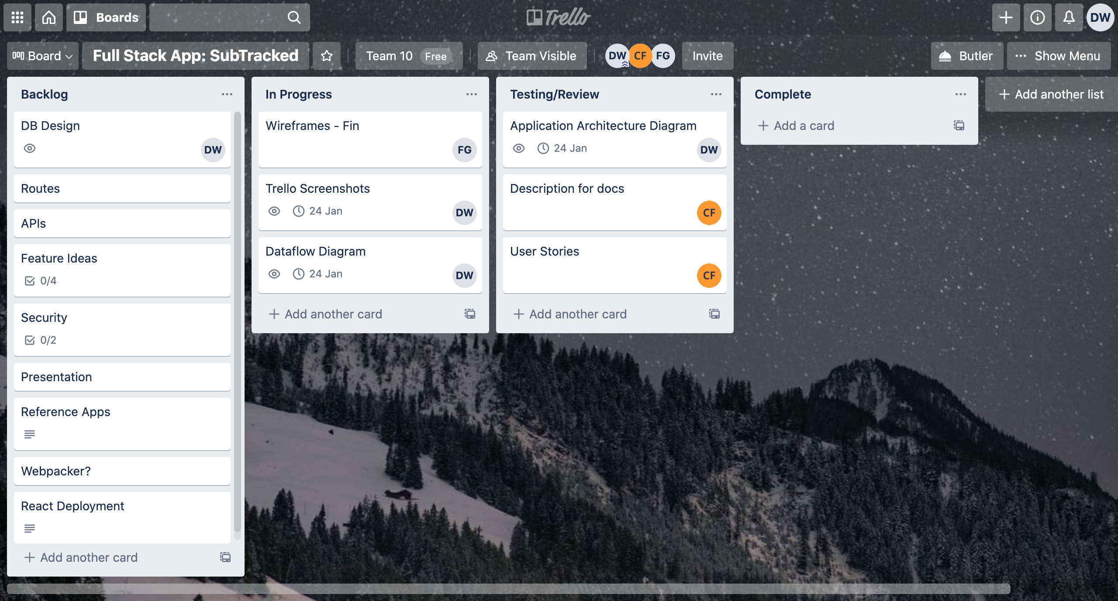
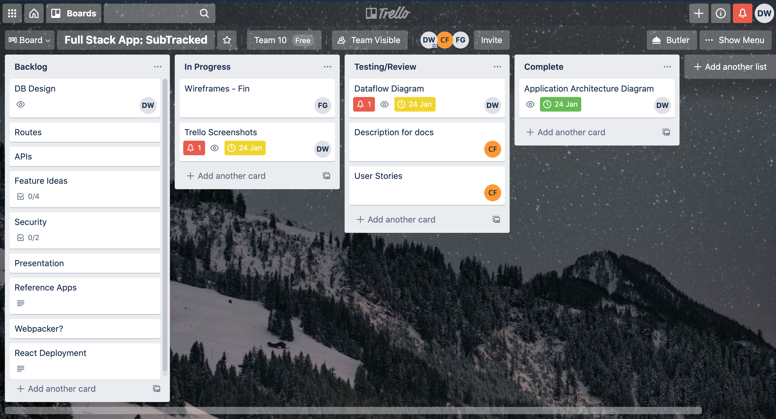
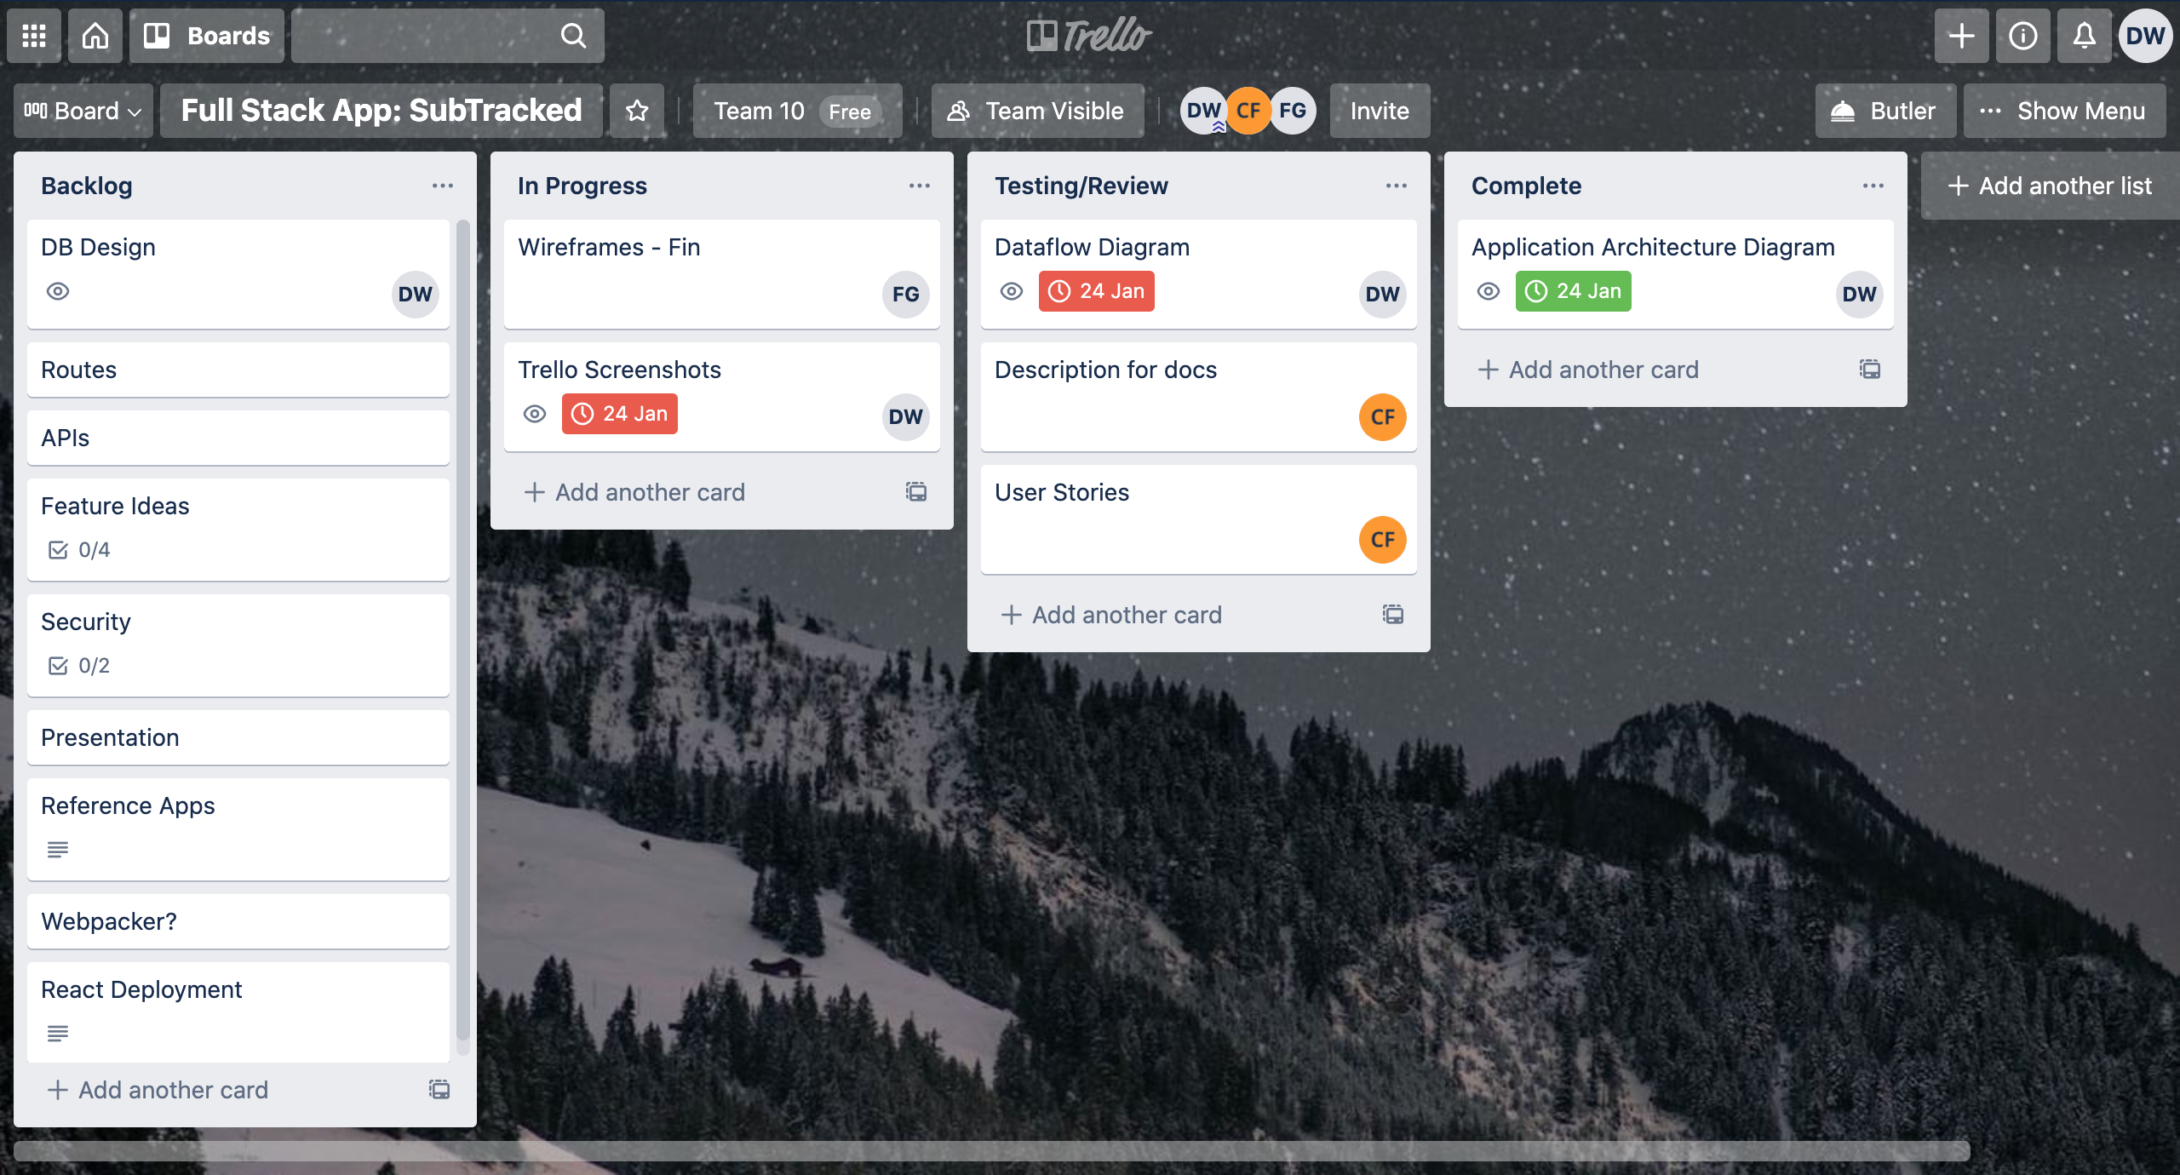
Task Management - Trello
Day 1
Day 2
Day 3
Day 5
Day 6
Day 7

Slide 9
Wireframes

